Slide 1
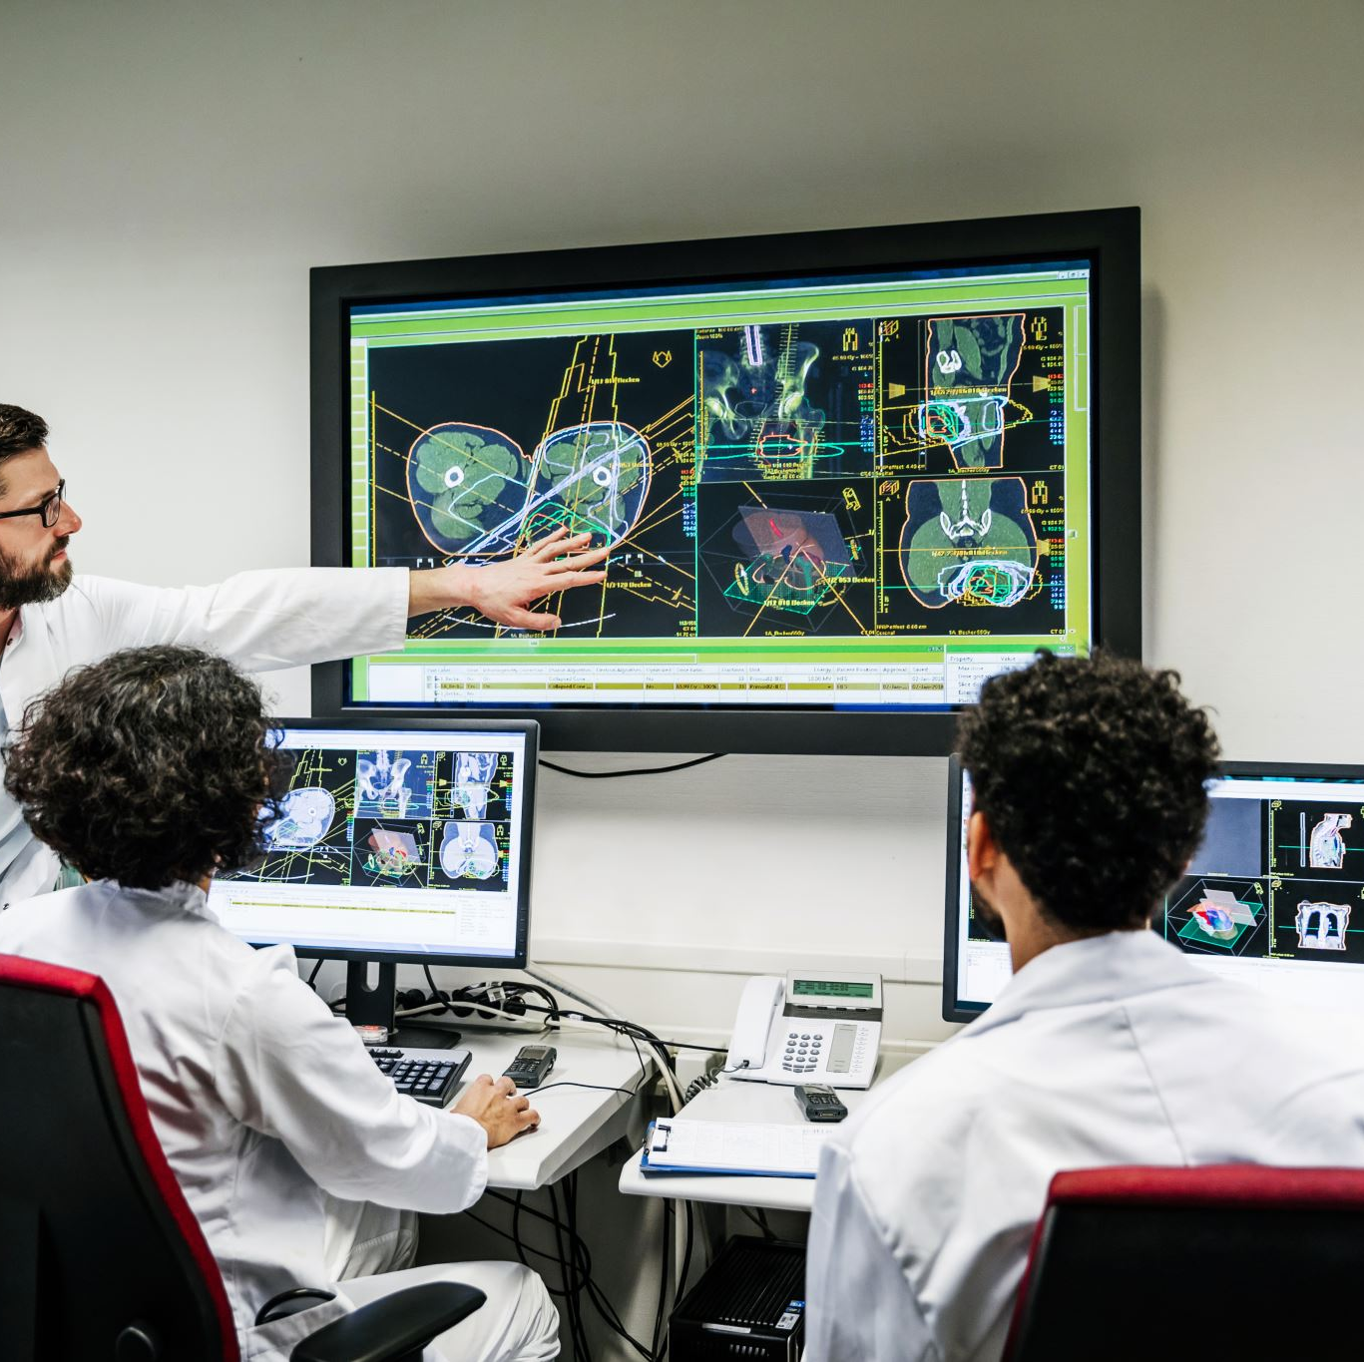
AI Product Presentation: Medical Image Diagnostic Assistant
Team A.I. Avengers:
Stanley Huynh
Win Ko Aung
Tales Araujo Leonidas

Slide 2

Medical Image Diagnostic Assistant
Enhancing Diagnostics Through AI

Slide 3
Purpose
To provide accurate and predictive analysis to support healthcare providers in their diagnostic processes.
To empower healthcare providers with advanced diagnostic support.
To improve patient care.

Slide 4
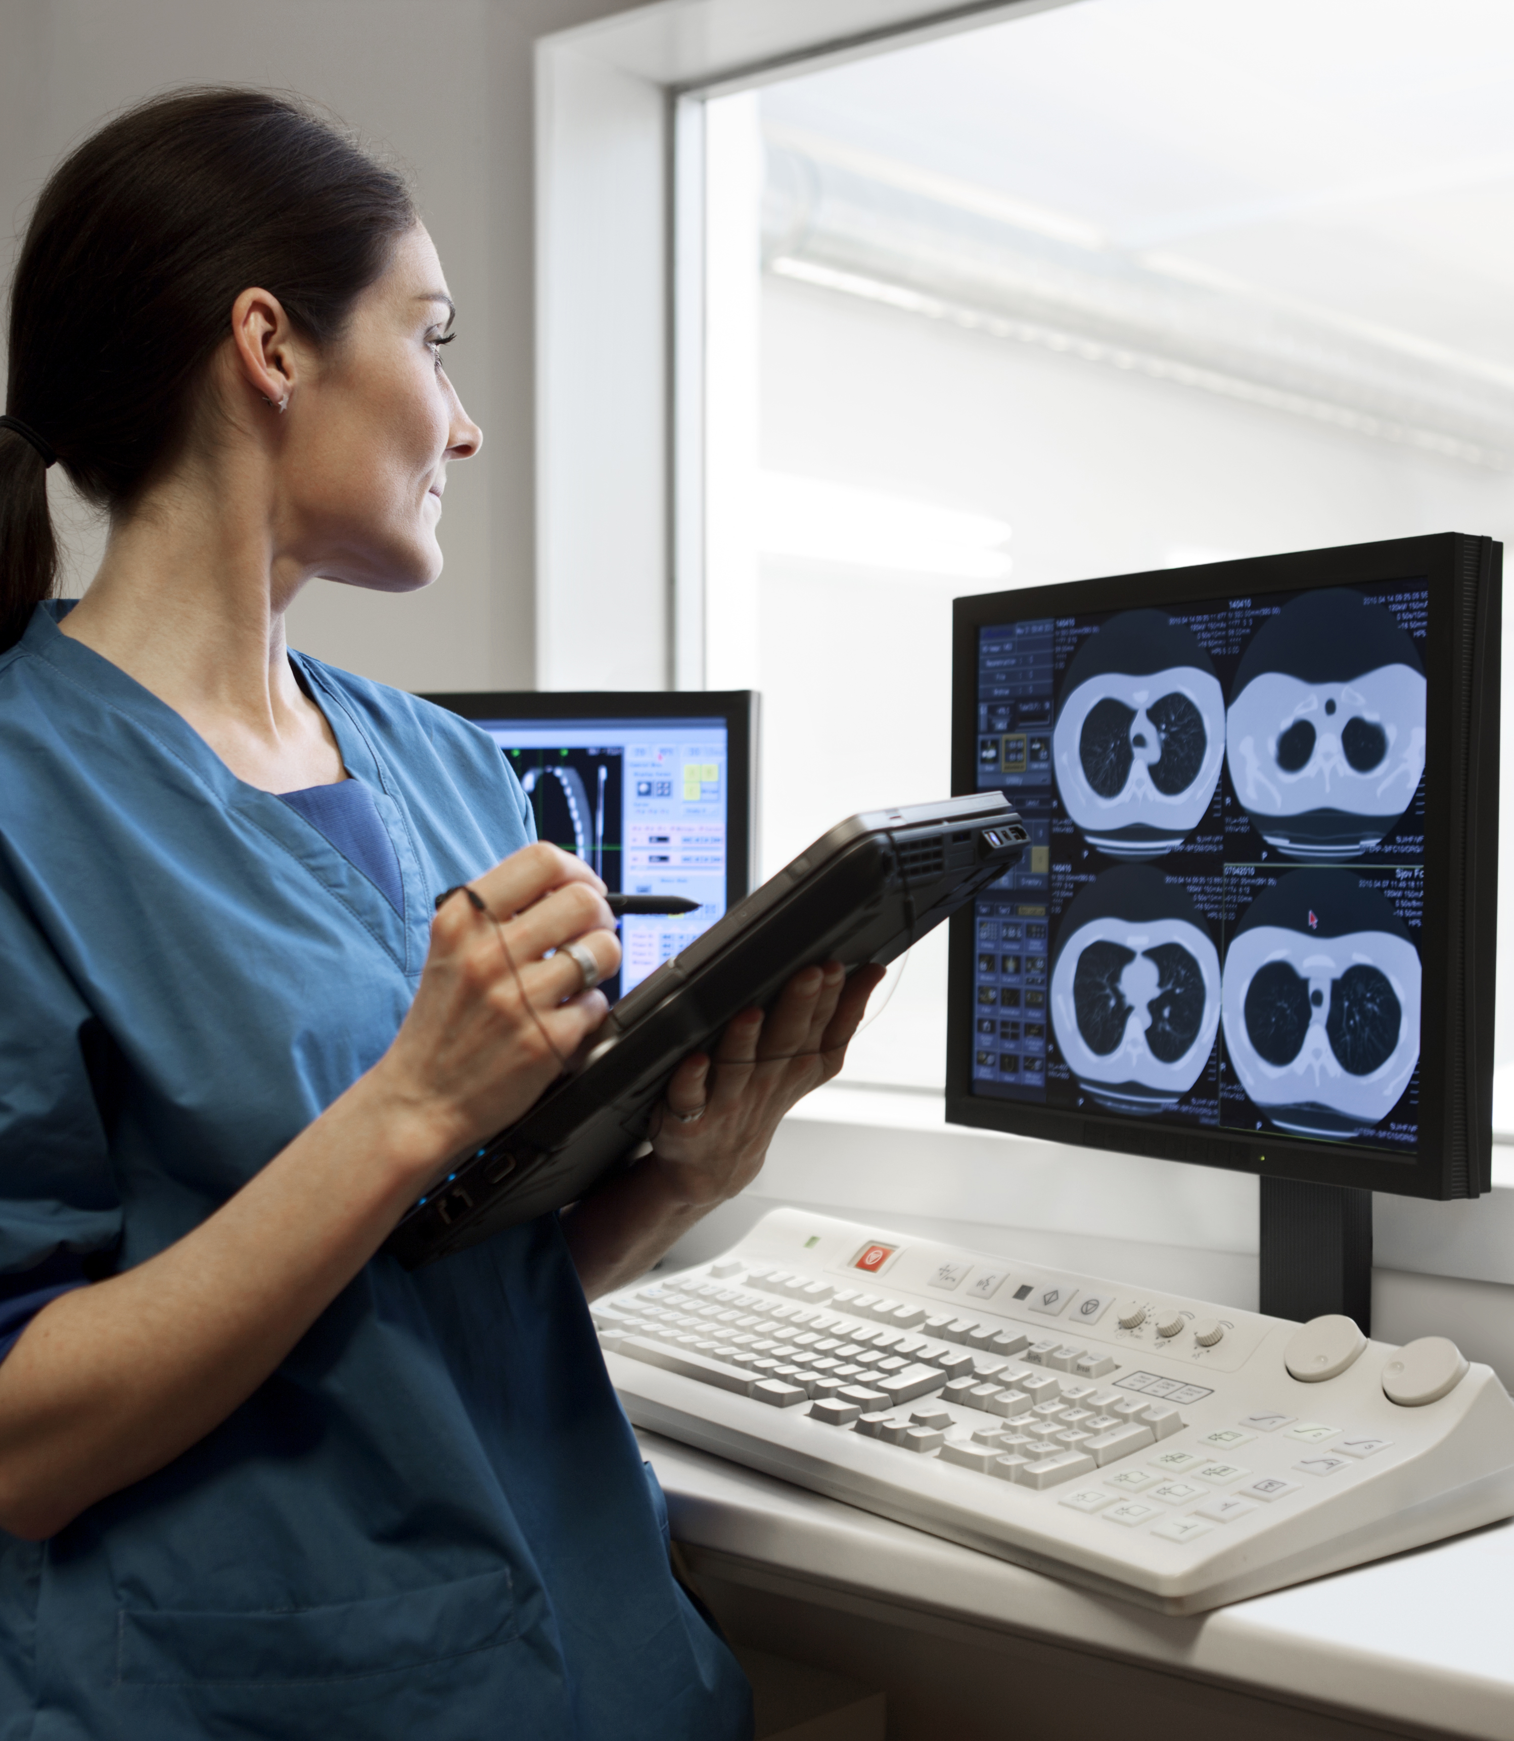
Functionality
Features:
X-ray Analysis: Detects anomalies in X-ray images.
Ultrasound Scans: Identifies patterns and potential issues.
MRI Analysis: Predicts abnormalities in brain structure and anatomy.
User-Friendly Interface: Intuitive tools for healthcare providers to interpret and verify the Assistant's findings.

Slide 5

Ethical Considerations
AI Ethicist / Government Regulator (Win Aung)
Bias Mitigation:
Diverse Dataset: Ensuring representation across demographics.
Transparency:
Explainable AI: Providing understandable insights for healthcare professionals.
Regulatory Compliance: Adhering to healthcare and AI industry standards.

Slide 6

Ethical Considerations (Continued)
Consumer Advocate / Product Manager (Tales Araujo Leonidas)
User Advocacy:
Informed Consent: Ensuring users understand and agree to AI assistance.
Usability: Prioritizing features that enhance user experience.
Accessibility:
Addressing concerns related to user accessibility and affordability.

Slide 7

Ethical Considerations (Continued)
Data Scientist (Stanley Huynh)
Privacy Measures:
Anonymization: Protecting patient data during AI model training.
Continuous Improvement:
Regular Updates: Enhancing model accuracy and reliability.

Slide 8

Conclusion
Our Medical Image Diagnostic Assistant is designed to provide accurate and predictive analysis, empowering healthcare providers with advanced diagnostic support prioritizing accuracy, transparency, user experience, and privacy.
We are committed to ongoing collaboration for continuous improvement in our mission, such as regular updates for enhanced accuracy and reliability to advance healthcare diagnostics.

